Slide 1
1/31 Class 4 – Identity Resolution
Look at Homework 3 – find Thomas Williams
Fuzzy matching for names, addresses
Modeling algorithm: decision trees

Slide 2
Ad Hoc Fuzzy Matching Algorithms
Some fields have idiosyncrasies that require deep understanding before building a fuzzy matching algorithm
Examples:
Birthdate: 03241987, 19870324, 03-24-1987
SSN: 123456789
phone number: 123-456-7890
credit card numbers: 5425287428753847
Really hard fields: name, addresses
month
day
year
state
time
sequential
area code
exchange
number
Bank identification number
Industry identifier
account
check sum

Slide 3
Find Records For a Thomas Williams
The FBI came to our NY organization and asked for help. They got a tip that someone named Thomas Williams is involved in some criminal activity.
They want us to find all the property records in our data that are associated with a person named Thomas Williams.

Slide 4
My Guidance Email Sent Tuesday
We can assume the request was the result of something the FBI heard rather than read, so we’ll be looking for last names that sound the same as Williams. It could be spelled a little differently but it would sound like Williams. Note, Williamson doesn’t sound like Williams.
Since we heard the first name is Thomas we can restrict ourselves to male first names. We should consider alternative versions of the first name Thomas that could still use “Thomas” as the more formal version of the first name.
Last name must sound like Williams (not Williamson). Might have small spelling variations.
Note, sometimes last names are hyphenated. Then the entire hyphenated string is the last name.
Look for typical first name variations of Thomas.
Don’t include names that are highly likely to be female.

Slide 5
Fuzzy Matching Algorithms for Names
The name field can be structured many ways
John Smith
Smith, John
Smith John
John Henry Smith
Smith, John Henry
John H. Smith
John H. Smith-Carlson (what’s the last name?)
…
There are hundreds of possible prefixes, suffixes:
Mr, Mrs, Ms, Prof, Dr, Rev, Atty. Col, Cmdr, Adm, Father, Hon, Rev…
Jr, Sr, II, III, IV, DDS, Esq, JD, MD, PhD, CPA, DDS, LLD, Ret, RN, DO…
Look at word document

Slide 6
Other Complications for Names
Surname prefixes, spaces, dashes, many parts
Special characters
ä, å, à, á, â, æ, ā, ç, č, ę, î, į, ł, œ, ż, ß, ø, ®, ©, -, &, ‘, (, ), /, “, #, 0, 1, 2, 3, 4…
MacDonald
McPherson
Mc Pherson
ODonnel
O’Donnel
O’ Donnel
Marie-Jose
Quiñones
Meyer-ter-Vehn
Ben-Gurion
De Gaulle
De La Guerra
Al-Fashi
Van der Waals
Chun-ying
Eli’av
Eduarda de Canto e Mello
Ottovordemgentschenfelde

Slide 7
First Name Variations (Nicknames)
Many people use different versions of their first name
Some more formal, some informal, some nicknames
Examples:
Stephen, Steve, Stevie
John, Johnny, Johnie, Jack…
Margaret, Peggy, Peg…
Data to find nicknames:
~2 billion applications for credit cards, cell phones, other credit
Group by person (can use SSN)
Examine all the different first name variations for all first names
From this analysis we built a “Nickname Table” that maps many variations to a root first name

Slide 8
Sample of Nickname Table
Root name
First name variations

Slide 9
First/Last Name Switching
Some name pairs are ambiguous about which is the first and last name
Smith John or John Smith?
Ashley Noel – both names are common first names
Thomas Bradley – Both names are common first and last names
Can build statistical tables to measure the likelihood each name element is more common as a first or last name, and then build a statistical first/last name switching algorithm
Maybe put more weight on how you see it written (fn ln)
Can use commercial name standardization software (e.g., Melissa Data, IBM, Oracle, Python name_cleaver…)
ROTHSCHILD 212, STANFORD Z MR -> Stanford Z Rothschild
Baird, Frederick A 'Tripp' III -> Frederick A 'Tripp' Baird III

Slide 10
First/Last Name Switching Problems
Some example ambiguous first/last names

Slide 11
Question: Are These the Same People?
If 2 of these Thomas Williams share the same birthday, would you guess that they are the same person?
How would you decide?
What’s the probability that two of these records will “accidentally” share the same birthday?
This problem is part of Identity Resolution: determine which identity/person is this for each record.

Slide 12
Question:
If 2 of these Thomas Williams share the same birthday, what’s the likelihood that they are the same person?

Slide 13
Fuzzy Matching Algorithms for Addresses
The address field has several subfields
123 MAIN ST (number, street name, street type)
123 N MAIN ST (predirectional)
123 MAIN ST S (postdirectional)
123 Main ST apt 12 (secondary unit designator/SUD)
These different subfields must be parsed carefully and then matched/compared using specific logic

Slide 14
Address Directionals
The 8 standard directions are N, S, E, W, NE, NW, SE, SW
Single predirectionals:
NORTH BAY ST or N BAY ST
EAST END AVE or E END AVE
Single postdirectionals:
BAY DRIVE WEST or BAY DR W
Two directionals:
NORTH EAST MAIN ST
NORTH SOUTH OAK ST
Directionals as part of the street name:
BAY W DRIVE
NORTH AVE

Slide 15
Secondary Unit Designator Variations
The Post Office recognizes 24 different legitimate SUDs
Additionally, the same address can be written with many legitimate variations of SUD:
123 MAIN ST UNIT 3
123 MAIN ST APT 3
123 MAIN ST # 3
123 MAIN ST FL 3
123 MAIN ST 3RD FL
123 MAIN ST 3RDFL
All these variations are the same address

Slide 16
Street Numbers Can Be Fractional
Fractional street numbers exist and can be written in a variety of ways:
123 1/2 MAIN ST
123&1/2 MAIN ST
123.5 MAIN ST
123 ONE HALF MAIN ST
12312 MAIN ST

Slide 17
Many Variations of Street Type
17 pages…

Slide 18
Example Variations of the Same Address
Makes address matching very hard to get right
Deliberate manipulation by the same person. House has no apartments.

Slide 19
Identity Resolution: Are These Two John Smiths the Same Person?
Date Seen (record date)
Name
Address
Phone
05/23/2009
Johnny Smith
426 Main St Apt 204
202 983 8475
11/03/2015
John T. Smith
426 Main St Apt 115
202 643 5639
Identity resolution is a particular kind of entity resolution, where the entity is a person
It’s important in many business problems, including fraud
How to do entity resolution?

Slide 20
Identity Resolution Machine
Unique person label:
Personal Identifying Number
(PIN)
Event with Personal Identifying Information (PII)
Identity Resolution Machine
PIN
Two main parts:
Carefully constructed data system
Complex fuzzy matching algorithms

Slide 21
Identity Resolution: Build the Data System
Data Available, ~10 year time frame:
~ 2 billion applications for credit cards, loans, cell phones
SNAPD (SSN, Name, Address, Phone, Date of birth, email
~340 million credit bureau header records/month
SNAPD, ~40 billion records (many are identical)
~200 million US phone book records/month (NAP)
NAP, ~20 billion records (many are identical)
Record
SSN
Name
Address
Phone
Dob
email
NameDob
Record
SSN
Name
Address
Phone
Dob
email
NameDob
Compare fields individually. If close, compare other fields.
Use agglomerative clustering with hierarchical field fuzzy matching algorithms.
Decide if records refer to the same person.
Assemble all records into people-groups.

Slide 22
Identity Resolution: People-Centric Data
More permanent to less permanent
Person 1
SSN
Dob
FNroot
FN
MN
LN
Address
Phone
email
list
list
list
list
list
list
list
list
list
Some lists short. SSN, Dob supposed to be unique/unchanging
Other lists can be fairly long (Address, Phone…)

Slide 23
PIN Data: Additional Complexities
t_{F0}
t_{F1}
t_{L1}
t_{L0}
c
Each list elements contained other info: first seen, likely first, likely last, last seen, # counts
Each PIN record has complex hierarchical layout to better record history
PIN₁
SSN₁
Dob₁
Dob₂
SSN₂
Dob₁
Dob₂

Slide 24
Identity Resolution: Field Fuzzy Matching Algorithms
Each Personal Identifying Information (PII) field has a custom fuzzy matching algorithm
Name: Standardize/parse, use nickname table, fuzzy match (ngram, soundex)
Address: Standardize/parse, fuzzy match (APIN system)
SSN: (123456789) Parse, fuzzy match, look for single digit typos, digit switching typos
DOB: (03/21/1994): Parse, fuzzy match, look for closeness in both edit distance and time
Phone: (1234567890): Parse, fuzzy match, look for digit typos, closeness
Email: (johnsmith123@gmail.com): parse, fuzzy match on elements

Slide 25
Identity Resolution Requires Complex Custom Field Fuzzy Matching With Statistical Analysis
Each Personal Identifying Information (PII) field has a custom fuzzy matching algorithm
Need to understand the likelihood that field matching might just be a coincidence (birthday problem)
Need to accumulate good data, clean and organize it very carefully
Identity resolution is a fundamental necessary capability for many fraud and authentication business problems

Slide 26
Some Fraudsters Deliberately Manipulate Their Credentials
Submit multiple applications for products
Try to avoid being seen as duplicate applications
or
Try to avoid being linked to past bad activity
Change one or two digits in their SSN
Change a month, day or year in their DOB
Modify their first or last name
Modify their address so still delivered but defeats address matching algorithms

Slide 27



Examples of Professionals Who Manipulate Their IDs
Name
SSN
DOB
Narana A Patel
Doctor Narana Patel
Narana A Chandrasekhar
538247937
537247937
537247237
10/04/1975
4/04/1976
Dermatologist
in PA
Name
SSN
DOB
Pastor Kathy Davis
Kathy M Davis
Davis Kathy Parnell
Kathy M Burkle
Kathy Burkle-Davis
774549376
774379376
774369376
774369371
474369376
6/14/1951
8/14/1951
7/10/1952
7/14/1952
8/14/1952
Fellowship Outreach,
Incorporated in Alabama
Name
SSN
DOB
Ronald S Caldwell
R S Caldwell
712675171
712655171
711675171
10/26/1922
6/26/1956
6/26/1960
Lawyer in a small town in DE

Slide 28
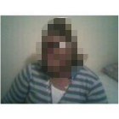
The Story of Candace Hogan
SSN | DOB | Name |  | Address | Zip | Date
S1 | 4/29/1982 | CANDACE | HOGAN | 6044 PRINGLE DR | 54215 | 5/9/2003
 |  |  |  | 989 GERTRUDE RD | 54211 | 9/12/2003
 |  |  |  | 3962 OAK GROVE RD | 54211 | 5/1/2004
 |  |  |  | 3246 S MILLBROOK RD # 3 | 54215 | 7/16/2004
 |  |  |  | 1396 KENDALL CV | 54214 | 12/20/2005
 |  |  |  | 5394 GLENDALE DR | 54215 | 3/23/2006
 |  |  |  | 4331 RUBY CV | 54211 | 4/12/2006
 |  |  |  | 3628 LEMON CT | 54218 | 6/5/2006
 |  |  |  | 4260 WESTWARD DR | 54216 | 7/17/2006
S2 | 4/29/1982 | CANDACE | HOGAN | 3271 APACHE RD | 54211 | 8/3/2005
S3 | 4/29/1982 | CANDACE | HOGAN | (blank) |  | 10/8/2008
S4 | 4/29/1982 | CANDICE | HOGAN | 3271 APACHE RD | 54211 | 11/16/2008
S5 | 4/29/1982 | CANDICE | HOGAN | 995 GERTRUDE RD | 54211 | 11/28/2008
S6 | 4/28/1982 | CANDICE | HOGAN | 3271 APACHE RD | 54211 | 1/30/2009
S7 | 4/20/1982 | CANDICE | HOGAN | 2304 SHORT DR | 54214 | 4/30/2009
S8 | 1/20/1981 | CANDACE | HOGAN | 3270 APACHE RD | 54211 | 6/21/2009
S9 | 5/29/1982 | CANDICE | HOGAN | 1205 KENTUCKY BLVD | 54206 | 10/19/2009
Normal,
then a string of activity with different addresses
Candace
on Facebook
LOTS of
address variation
over a short time
Uses a different SSN, address
Uses LOTS of new SSNs, along with variations in address, name, DOB
Very hard to identity as the same person.
Different SSNs, DOBs, addresses, name variations
2003
2004
2005
2006
2007
2008
2009
Notes:
Replace photo of Candace with stock
This is a standard text slide
Your title is 24 point and the second line wraps to the top as to not interfere with the subtitle.
The sub is 16 pt. There is also a layout version of this with no subtitle if you prefer.

Slide 29
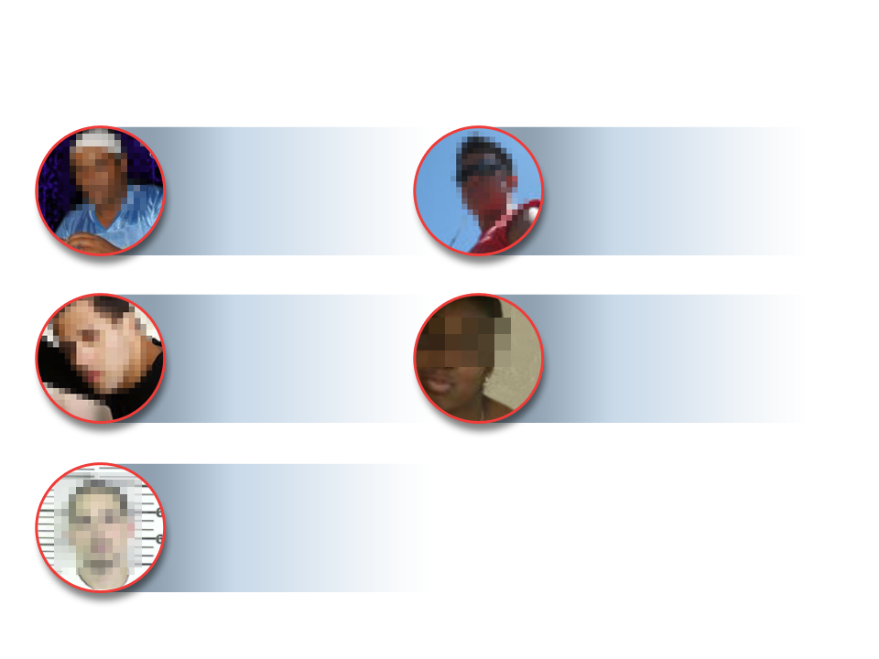
People Behaving Badly
Thomas
Uses 7 different SSNs
Nick
AKA N*****
Uses 4 different SSNs
DOB manipulation
Taj
AKA J****
Uses 2 different SSNs
Lots of DOB and address manipulation
Tamisha Z***
Defaulted on 3 wireless accounts
Reapplied successfully as
Tamisha V*** @ different address
Michael
Convicted sex offender
10 aliases, 6 SSNs, 5 DOBs
Found working at a children’s summer camp under an alias
Requires ability to see across many businesses and events
Notes:
Middle east
Latino
African am
African am
Add stock photos that resemble the “real” people in the photos

Slide 30
Example Severe Identity Manipulator
Likely SSN:
590530044
Likely DOB:
1/27/1969
9 different first names
5 different last names
24 different SSNs
11 different dates of birth
Suspicious address variation

Slide 31
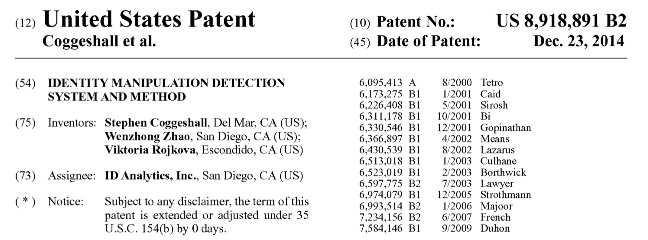
Must Distinguish Between Typos and Deliberate Manipulation
Look for frequent, systematic variation in fields
Many variations, each with a small difference
Example systematic field variations:
Numbers:
…2301
…2302
…2303
…2304
…2305
Dates:
3/24/1985
3/25/1985
3/26/1985
4/24/1984
3/24/1986
First names:
John
Jon
Johnny
Johny
Johnie
Last names:
Harrison
Harrisen
Harison
Harris
Harisen

Slide 32
Break

Slide 33
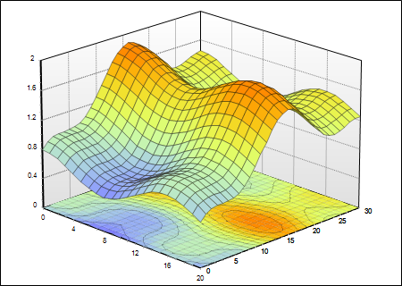
What is a Supervised Predictive ML Model?
The surface is y=f(x)
Look at max, min, mean, sd’s, distributions, do normalizations
y
x₁ x₂ x₃ … x_{n} y
x₁ x₂ x₃ … x_{n} y
Many
millions
x₁ x₂ x₃ … x_{n} y
x₁ x₂ x₃ … x_{n} y
x₁ x₂ x₃ … x_{n} y
…
x₂
x₁
Many hundreds
Think this way for data preparation, statistical analysis, normalization, standardization…
Think this way for model building process, algorithm design and selection
Building a machine learning model means fitting a best surface through the data points. This is the pretty much all we do when we build a model
The art of model building is finding this “best” surface

Slide 34
Decision Tree
A decision tree model carves up space into boxes and then assigns a score for each box
645
743
Simple two dimensional decision tree
The model building process decides where to draw the boxes and what the score in each box should be
4
356
x₂
457
Average of the dependent variable y in this box
2
x₁
5
Could be represented by a set of rules or graphically with a tree structure:
Any record
If x₁ < 2, score = 356
If x₁ > 2 and x₂ < 4, score = 457
if 2 < x₁ < 5 and x₂ > 4, score = 645
if x₁ > 5 and x₂ > 4, score = 743
yes
x₁ < 2?
no
Score = 356
x₂ < 4?
yes
no
Score = 457
x₁ < 5?
yes
no
Score = 645
Score = 743
A typical decision tree model will be in several or many dimensions
with 10s or hundreds of leaf nodes

Slide 35
The goodness of a candidate cutpoint is measured by the impurity of the resulting two boxes. Want low impurities on both sides. For continuous outputs we can use variance.
The total impurity of the resulting cut is
Common measures of impurity:
Variance:
Gini index:
Entropy or Information Gain:
Add the impurities of both resulting boxes weighted by the number in each box
Choose the best cutpoint that results in the lowest impurity
How Do Decision Trees Decide Where to Cut
Impurity of box 1
Number records in box 1
x₂
For good/bad
Box 1
Box 2
Candidate cutpoint
x₁
For good/bad

Slide 36
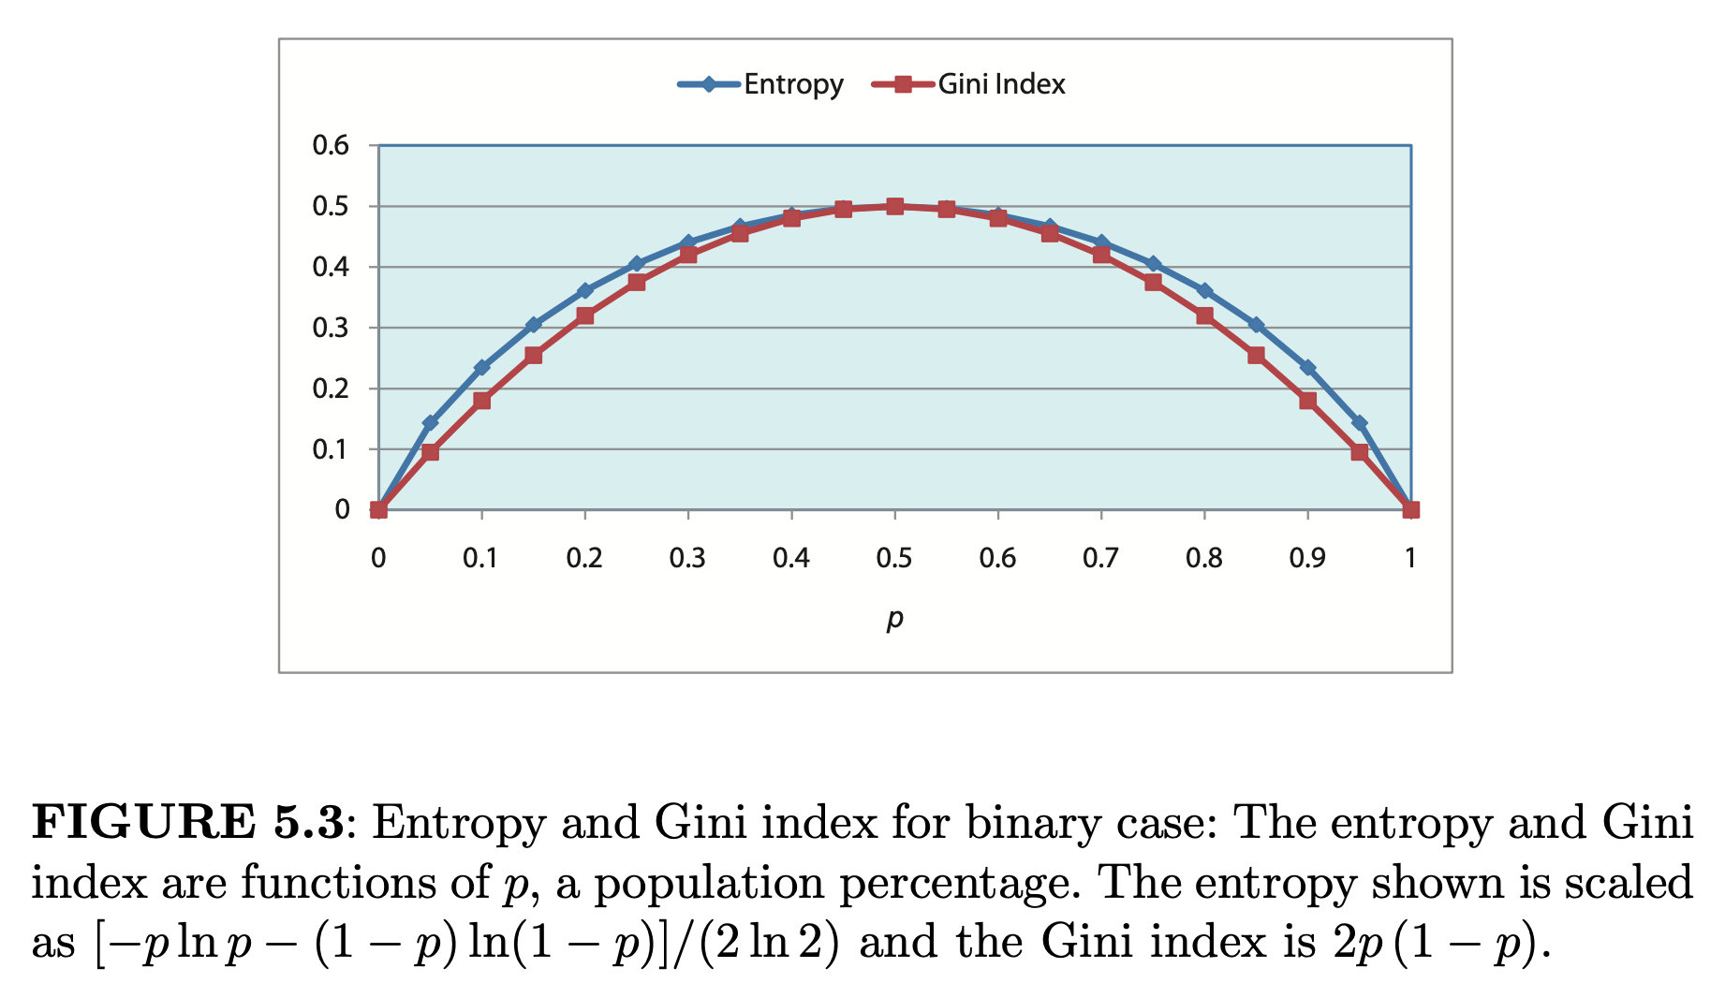
Compare Splitting Criterion: Gini or Entropy?
The splitting criterion measures are not that much different
Gini index:
Entropy or Information Gain:
For good/bad
For good/bad
Impurity of a box containing some goods and some bads
Not much different, but resulting trees will likely be different
Entropy a little slower to calculate
Try both, look at resulting trees and choose the one you like best
Maximum values if data classes are all mixed up
p(bad=.5)
Minimum values if data classes are completely separated:
p(bad=0)
Minimum values if data classes are completely separated:
p(bad=1)

Slide 37
How Do Decision Tree Algorithms Work
Start with a first candidate dimension/variable (x₁)
Start on one side of the dimension
Slide the candidate cutpoint until you pass the minimum # points for a leaf
Calculate the resulting total impurity of the candidate cut
Slide the cutpoint point until one point crosses over and update the impurity measure
Continue until cannot slide anymore
Go to the next dimension (x₂) and redo
Continue through all the dimensions
Chose the best cutpoint: the particular location in a particular dimension that minimized the resulting total impurity
Continue the same process in each of the resulting two boxes
Continue until stopping criterion reached (low enough total impurity, minimum points/leaf…)
x₂
Box 1
Box 2
Slide across
Candidate cutpoint
x₁

Slide 38
Decision Trees Can Be Complex
A real model might be a complex decision tree:
Important user-chosen parameters: splitting criterion, max depth, min split size, min leaf size
Frequently a complex tree is pruned, where branches/leaves are removed
Decision trees are fragile and unstable, prone to overfitting
A typical decision tree model carves up lots of boxes in moderate to high dimensional space.
This 2-d tree has 7 layers, 25 leaf nodes.
x₂
x₁

Slide 39
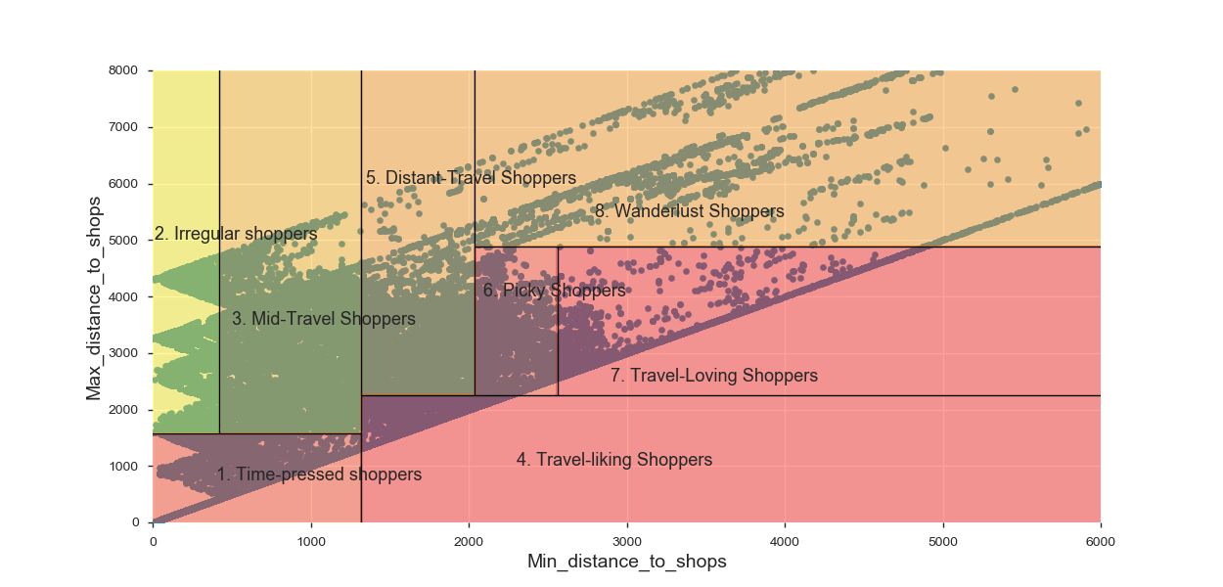
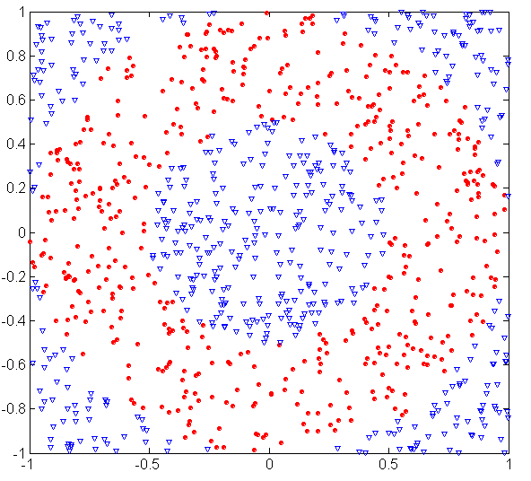
DTs Don’t Work Well for Some Problems
DTs work well when the problem naturally divides by lines parallel to the different axes
DTs don’t do well when the separation lines are at angles to the axis, or if the separation lines are substantially curved
DT doesn’t do well when the data/model directions aren’t parallel to the axes
DT doesn’t do well when the model directions are substantially curved
39

Slide 40
What Do We Do With Data to Build a Model
Raw data
Cleaned data
L+1 columns
L+1 columns
f₁ f₂ f₃ …. f_{L} y
f₁ f₂ 0 …. f_{L} y
f₁ na f₃ …. f_{L} y
…
f₁ f₂ na …. f_{L} y
Clean the data:
Fill in missing fields
Treat outliers
Remove exclusions
f₁ f₂ f₃ …. f_{L} y
f₁ f₂ f₃ …. f_{L} y
f₁ f₂ f₃ …. f_{L} y
…
f₁ f₂ f₃ …. f_{L} y
M rows
m rows
Typically missing some field values
Feature engineering: build n expert variables from the L fields
Data for the model
n+1 columns
x₁ x₂ x₃ …. x_{n} y
x₁ x₂ x₃ …. x_{n} y
x₁ x₂ x₃ …. x_{n} y
…
x₁ x₂ x₃ …. x_{n} y
n independent variables (x’s)
One dependent variable (y)
Many more rows than columns (m >> n)
The goal is y=F(x)
m rows

Slide 41
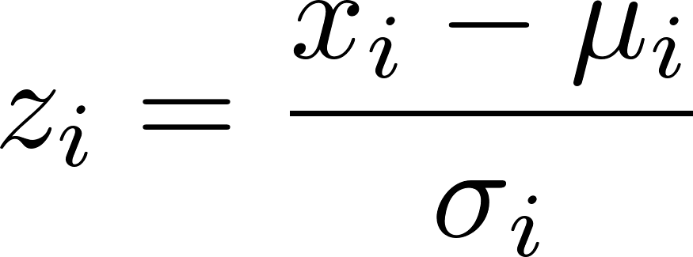
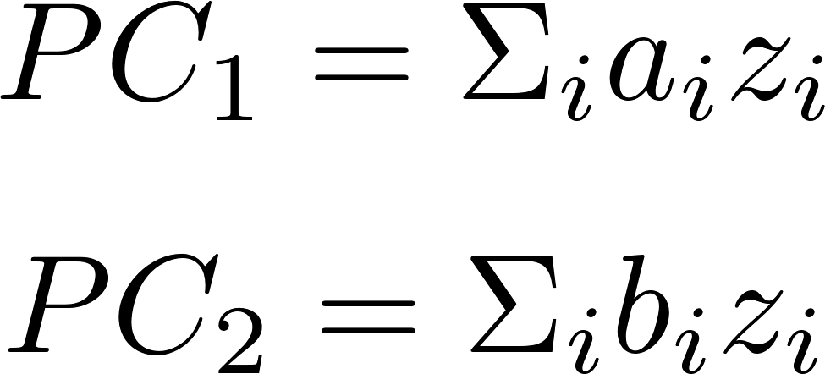
Unsupervised Fraud Algorithm
Build many expert variables that quantify signals for various fraud modes
Z scale to prepare for dimensionality reduction
Reduce dimensions via PCA, throw away all but top few PCs
~10¹
~10²
Original
data
Feature engineering
Expert
variables
(x’s)
~10⁶
~10⁶
~10²
~10²
x₁ …. x_{n}
x₁ …. x_{n}
Scaling
z₁ …. z_{n}
z₁ …. z_{n}
~10⁶
…
…
~10⁶
…
…
~10²
~10¹
z₁ …. z_{n}
z₁ …. z_{n}
Dimensionality
reduction
PC₁ …. PC_{n}
PC₁ …. PC_{n}
~10⁶
…
…
~10⁶
…
…
…

Slide 42
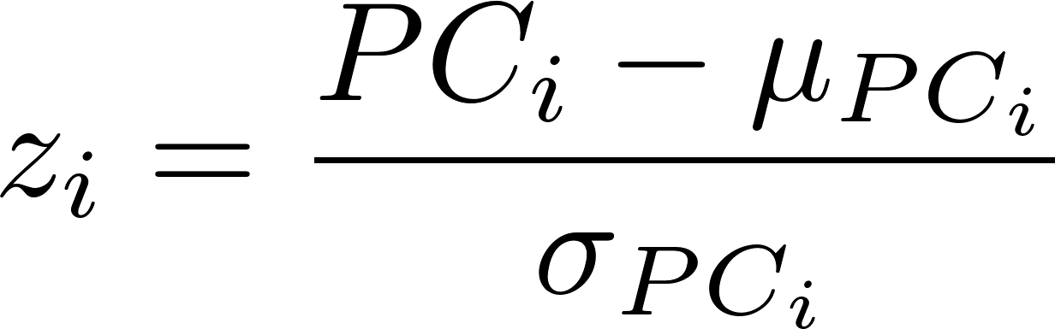
Unsupervised Fraud Algorithm continued
Z scale the reduced variables (the PC’s)
Score 1: The fraud score is any function of these zscores that looks for extremes:
~10¹
~10¹
PC₁ …. PC_{n}
PC₁ …. PC_{n}
z₁ …. z_{n}
z₁ …. z_{n}
~10⁶
Scaling
…
…
~10⁶
…
…
These are different z’s from the previous page
Score 2: (a) train an autoencoder on all the data to reproduce the z scaled PC records, then (b) the fraud score is any measure of difference between the original input record and the autoencoder output record, for example
Combine the two scores using weighted average rank orders to get the final score
6.
7.
Note that these score formulas are identical. The first finds the distance from the origin.

Slide 43
How To Use an Unsupervised Fraud Model
s
s
Score all records with the fraud algorithm
s
s
s
s
s
s
s
s
s
s
high
Investigate from the top down
s
s
Sort records by the score
s
s
s
s
s
s
s
s
low
Understand why the record is strange. Decide if legitimate.
Many of the top anomalous records are indeed strange but OK

Slide 44
Look at the Z Scaled Variables of the Top Records
Highest scoring records
z₁
z₂
z₃
z₄
z₅
z₆
z₇
Record 1
.94 -.31 43.2 -.042 10.4 -16.4 -2.34 …
Record 2
1.32 -18.3 2.43 3.12 -.13 36.4 4.21…
Record 3
24.2 .043 -3.21 2.12 .043 2.23 43.5 …
Record 4
2.32 4.21 -34.3 6.43 84.3 3.02 14.3 …
Can immediately see which variables have unusual values

